Slide 1

Cryptography and Network Security
Seventh Edition
by William Stallings
Notes:
Lecture slides prepared for “Cryptography and Network Security”, 7/e, by William Stallings, Chapter 4 – “Block Ciphers and the Data Encryption Standard”.

Slide 2
Chapter 4
Block Ciphers and the Data Encryption Standard
Notes:
The objective of this chapter is to illustrate the principles of modern symmetric
ciphers. For this purpose, we focus on the most widely used symmetric cipher: the Data
Encryption Standard (DES). Although numerous symmetric ciphers have been developed
since the introduction of DES, and although it is destined to be replaced by the
Advanced Encryption Standard (AES), DES remains the most important such algorithm.
Furthermore, a detailed study of DES provides an understanding of the principles
used in other symmetric ciphers.
This chapter begins with a discussion of the general principles of symmetric block
ciphers, which are the principal type of symmetric ciphers studied in this book. The
other form of symmetric ciphers, stream ciphers, are discussed in Chapter 8. Next, we
cover full DES. Following this look at a specific algorithm, we return to a more general
discussion of block cipher design.
Compared to public-key ciphers, such as RSA, the structure of DES and most
symmetric ciphers is very complex and cannot be explained as easily as RSA and similar
algorithms. Accordingly, the reader may wish to begin with a simplified version of
DES, which is described in Appendix G. This version allows the reader to perform
encryption and decryption by hand and gain a good understanding of the working of
the algorithm details. Classroom experience indicates that a study of this simplified
version enhances understanding of DES.
Several important symmetric block encryption algorithms in current use are based
on a structure referred to as a Feistel block cipher [FEIS73]. For that reason, it is
important to examine the design principles of the Feistel cipher. We begin with a
comparison of stream ciphers and block ciphers. Then we discuss the motivation for
the Feistel block cipher structure. Finally, we discuss some of its implications.

Slide 3
Stream Cipher
Encrypts a digital data stream one bit or one byte at a time
Examples:
Autokeyed Vigenère cipher
Vernam cipher
In the ideal case, a one-time pad version of the Vernam cipher would be used, in which the keystream is as long as the plaintext bit stream
If the cryptographic keystream is random, then this cipher is unbreakable by any means other than acquiring the keystream
Keystream must be provided to both users in advance via some independent and secure channel
This introduces insurmountable logistical problems if the intended data traffic is very large
For practical reasons the bit-stream generator must be implemented as an algorithmic procedure so that the cryptographic bit stream can be produced by both users
It must be computationally impractical to predict future portions of the bit stream based on previous portions of the bit stream
The two users need only share the generating key and each can produce the keystream
Notes:
A stream cipher is one that encrypts a digital data stream one bit or one byte at
a time. Examples of classical stream ciphers are the autokeyed Vigenère cipher
and the Vernam cipher. In the ideal case, a one-time pad version of the Vernam
cipher would be used (Figure 3.7), in which the keystream (k_{i} ) is as long as the
plaintext bit stream (p_{i} ). If the cryptographic keystream is random, then this cipher
is unbreakable by any means other than acquiring the keystream. However, the
keystream must be provided to both users in advance via some independent and
secure channel. This introduces insurmountable logistical problems if the intended
data traffic is very large.
Accordingly, for practical reasons, the bit-stream generator must be
implemented as an algorithmic procedure, so that the cryptographic bit stream
can be produced by both users. In this approach (Figure 4.1a), the bit-stream
generator is a key-controlled algorithm and must produce a bit stream that is
cryptographically strong. That is, it must be computationally impractical to
predict future portions of the bit stream based on previous portions of the bit
stream. The two users need only share the generating key, and each can produce
the keystream.

Slide 4
Block Cipher
A block of plaintext is treated as a whole and used to produce a ciphertext block of equal length
Typically a block size of 64 or 128 bits is used
As with a stream cipher, the two users share a symmetric encryption key
The majority of network-based symmetric cryptographic applications make use of block ciphers
Notes:
A block cipher is one in which a block of plaintext is treated as a whole
and used to produce a ciphertext block of equal length. Typically, a block size of
64 or 128 bits is used. As with a stream cipher, the two users share a symmetric
encryption key (Figure 4.1b). Using some of the modes of operation explained
in Chapter 7, a block cipher can be used to achieve the same effect as a stream
cipher.
Far more effort has gone into analyzing block ciphers. In general, they seem
applicable to a broader range of applications than stream ciphers. The vast majority
of network-based symmetric cryptographic applications make use of block
ciphers. Accordingly, the concern in this chapter, and in our discussions throughout
the book of symmetric encryption, will primarily focus on block ciphers.

Slide 5
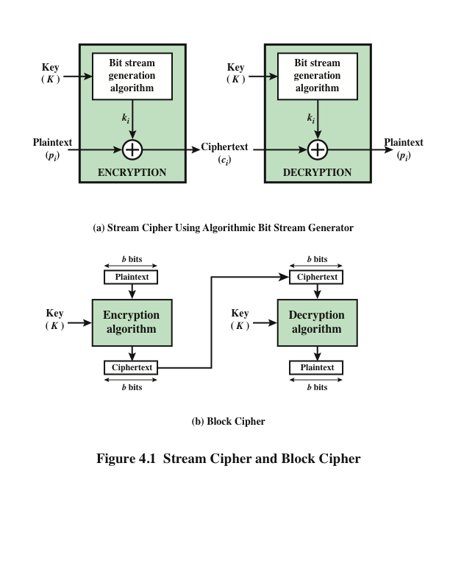
Notes:
Examples of stream and block ciphers.

Slide 6
Feistel Cipher
Feistel proposed the use of a cipher that alternates substitutions and permutations
Is a practical application of a proposal by Claude Shannon to develop a product cipher that alternates confusion and diffusion functions
Is the structure used by many significant symmetric block ciphers currently in use
Substitutions
Each plaintext element or group of elements is uniquely replaced by a corresponding ciphertext element or group of elements
Permutation
No elements are added or deleted or replaced in the sequence, rather the order in which the elements appear in the sequence is changed
Notes:
Feistel proposed [FEIS73] that we can approximate the ideal block cipher by utilizing
the concept of a product cipher, which is the execution of two or more simple ciphers
in sequence in such a way that the final result or product is cryptographically stronger
than any of the component ciphers. The essence of the approach is to develop a block
cipher with a key length of k bits and a block length of n bits, allowing a total of 2^{k}
possible transformations, rather than the 2^{n} ! transformations available with the ideal
block cipher.
In particular, Feistel proposed the use of a cipher that alternates substitutions
and permutations, where these terms are defined as follows:
• Substitution: Each plaintext element or group of elements is uniquely replaced
by a corresponding ciphertext element or group of elements.
• Permutation: A sequence of plaintext elements is replaced by a permutation
of that sequence. That is, no elements are added or deleted or replaced in the
sequence, rather the order in which the elements appear in the sequence is
changed.
In fact, Feistel’s is a practical application of a proposal by Claude Shannon
to develop a product cipher that alternates confusion and diffusion functions
[SHAN49]. We look next at these concepts of diffusion and confusion and then
present the Feistel cipher. But first, it is worth commenting on this remarkable fact:
The Feistel cipher structure, which dates back over a quarter century and which, in
turn, is based on Shannon’s proposal of 1945, is the structure used by many significant
symmetric block ciphers currently in use.
In particular, the Feistel structure
is used for Triple Data Encryption Algorithm (TDEA), which is one of the two
encryption algorithms (along with AES), approved for general use by the National
Institute of Standards and Technology (NIST). The Feistel structure is also used for
several schemes for format-preserving encryption, which have recently come into
prominence. In addition, the Camellia block cipher is a Feistel structure; it is one
of the possible symmetric ciphers in TLS and a number of other Internet security
protocols. Both TDEA and format-preserving encryption are covered in Chapter 7.

Slide 7
Diffusion and Confusion
Terms introduced by Claude Shannon to capture the two basic building blocks for any cryptographic system
Shannon’s concern was to thwart cryptanalysis based on statistical analysis
Diffusion
The statistical structure of the plaintext is dissipated into long-range statistics of the ciphertext
This is achieved by having each plaintext digit affect the value of many ciphertext digits
Confusion
Seeks to make the relationship between the statistics of the ciphertext and the value of the encryption key as complex as possible
Even if the attacker can get some handle on the statistics of the ciphertext, the way in which the key was used to produce that ciphertext is so complex as to make it difficult to deduce the key
Notes:
The terms diffusion and confusion were introduced by
Claude Shannon to capture the two basic building blocks for any cryptographic
system [SHAN49]. Shannon’s concern was to thwart cryptanalysis based on statistical
analysis. The reasoning is as follows. Assume the attacker has some knowledge
of the statistical characteristics of the plaintext. For example, in a human-readable
message in some language, the frequency distribution of the various letters may be
known. Or there may be words or phrases likely to appear in the message (probable
words). If these statistics are in any way reflected in the ciphertext, the cryptanalyst
may be able to deduce the encryption key, part of the key, or at least a set of keys
likely to contain the exact key. In what Shannon refers to as a strongly ideal cipher,
all statistics of the ciphertext are independent of the particular key used. The arbitrary
substitution cipher that we discussed previously (Figure 4.2) is such a cipher,
but as we have seen, it is impractical.
Other than recourse to ideal systems, Shannon suggests two methods for
frustrating statistical cryptanalysis: diffusion and confusion. In diffusion , the
statistical structure of the plaintext is dissipated into long-range statistics of the
ciphertext. This is achieved by having each plaintext digit affect the value of many
ciphertext digits; generally, this is equivalent to having each ciphertext digit be
affected by many plaintext digits.
Every block cipher involves a transformation of a block of plaintext into a
block of ciphertext, where the transformation depends on the key. The mechanism
of diffusion seeks to make the statistical relationship between the plaintext and
ciphertext as complex as possible in order to thwart attempts to deduce the key. On
the other hand, confusion seeks to make the relationship between the statistics of
the ciphertext and the value of the encryption key as complex as possible, again to
thwart attempts to discover the key. Thus, even if the attacker can get some handle
on the statistics of the ciphertext, the way in which the key was used to produce that
ciphertext is so complex as to make it difficult to deduce the key. This is achieved by
the use of a complex substitution algorithm. In contrast, a simple linear substitution
function would add little confusion.
As [ROBS95b] points out, so successful are diffusion and confusion in capturing
the essence of the desired attributes of a block cipher that they have become the
cornerstone of modern block cipher design.

Slide 8
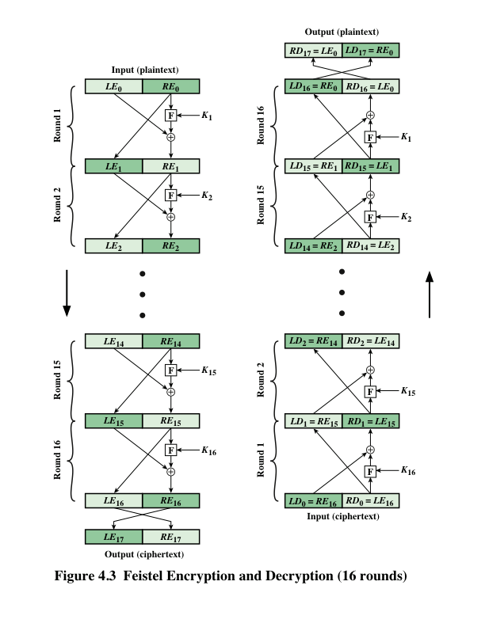
Notes:
The left-hand side of Figure 4.3 depicts the structure
proposed by Feistel. The inputs to the encryption algorithm are a plaintext block of
length 2w bits and a key K . The plaintext block is divided into two halves, LE₀ and RE₀ .
The two halves of the data pass through n rounds of processing and then combine to
produce the ciphertext block. Each round i has as inputs LE_{i-1} and RE_{i-1} derived from
the previous round, as well as a subkey K_{i} derived from the overall K . In general,
the subkeys K_{i} are different from K and from each other. In Figure 4.3, 16 rounds
are used, although any number of rounds could be implemented.
All rounds have the same structure. A substitution is performed on the left half
of the data. This is done by applying a round function F to the right half of the data
and then taking the exclusive-OR of the output of that function and the left half of the
data. The round function has the same general structure for each round but is parameterized
by the round subkey K_{i} . Another way to express this is to say that F is a function
of right-half block of w bits and a subkey of y bits, which produces an output value
of length w bits: F (RE_{i} , K_{i+1} ). Following this substitution, a permutation is performed
that consists of the interchange of the two halves of the data. This structure is a particular
form of the substitution-permutation network (SPN) proposed by Shannon.

Slide 9
Feistel Cipher Design Features
Block size
Larger block sizes mean greater security but reduced encryption/decryption speed for a given algorithm
Key size
Larger key size means greater security but may decrease encryption/decryption speeds
Number of rounds
The essence of the Feistel cipher is that a single round offers inadequate security but that multiple rounds offer increasing security
Subkey generation algorithm
Greater complexity in this algorithm should lead to greater difficulty of cryptanalysis
Round function F
Greater complexity generally means greater resistance to cryptanalysis
Fast software encryption/decryption
In many cases, encrypting is embedded in applications or utility functions in such a way as to preclude a hardware implementation; accordingly, the speed of execution of the algorithm becomes a concern
Ease of analysis
If the algorithm can be concisely and clearly explained, it is easier to analyze that algorithm for cryptanalytic vulnerabilities and therefore develop a higher level of assurance as to its strength
Notes:
The exact realization of a Feistel network depends on the choice of the following
parameters and design features:
• Block size: Larger block sizes mean greater security (all other things being
equal) but reduced encryption/decryption speed for a given algorithm. The
greater security is achieved by greater diffusion. Traditionally, a block size of
64 bits has been considered a reasonable tradeoff and was nearly universal in
block cipher design. However, the new AES uses a 128-bit block size.
• Key size: Larger key size means greater security but may decrease encryption/
decryption speed. The greater security is achieved by greater resistance to
brute-force attacks and greater confusion. Key sizes of 64 bits or less are now
widely considered to be inadequate, and 128 bits has become a common size.
• Number of rounds: The essence of the Feistel cipher is that a single round
offers inadequate security but that multiple rounds offer increasing security.
A typical size is 16 rounds.
• Subkey generation algorithm: Greater complexity in this algorithm should
lead to greater difficulty of cryptanalysis.
• Round function F: Again, greater complexity generally means greater resistance
to cryptanalysis.
There are two other considerations in the design of a Feistel cipher:
• Fast software encryption/decryption: In many cases, encryption is embedded in
applications or utility functions in such a way as to preclude a hardware implementation.
Accordingly, the speed of execution of the algorithm becomes a
concern.
• Ease of analysis: Although we would like to make our algorithm as difficult as
possible to cryptanalyze, there is great benefit in making the algorithm easy to
analyze. That is, if the algorithm can be concisely and clearly explained, it is
easier to analyze that algorithm for cryptanalytic vulnerabilities and therefore
develop a higher level of assurance as to its strength. DES, for example, does
not have an easily analyzed functionality.

Slide 10
Data Encryption Standard (DES)
Issued in 1977 by the National Bureau of Standards (now NIST) as Federal Information Processing Standard 46
Was the most widely used encryption scheme until the introduction of the Advanced Encryption Standard (AES) in 2001
Algorithm itself is referred to as the Data Encryption Algorithm (DEA)
Data are encrypted in 64-bit blocks using a 56-bit key
The algorithm transforms 64-bit input in a series of steps into a 64-bit output
The same steps, with the same key, are used to reverse the encryption
Notes:
Until the introduction of the Advanced Encryption Standard (AES) in 2001, the
Data Encryption Standard (DES) was the most widely used encryption scheme.
DES was issued in 1977 by the National Bureau of Standards, now the National
Institute of Standards and Technology (NIST), as Federal Information Processing
Standard 46 (FIPS PUB 46). The algorithm itself is referred to as the Data
Encryption Algorithm (DEA). For DEA, data are encrypted in 64-bit blocks using
a 56-bit key. The algorithm transforms 64-bit input in a series of steps into a 64-bit
output. The same steps, with the same key, are used to reverse the encryption.
Over the years, DES became the dominant symmetric encryption algorithm,
especially in financial applications. In 1994, NIST reaffirmed DES for federal use
for another five years; NIST recommended the use of DES for applications other
than the protection of classified information. In 1999, NIST issued a new version
of its standard (FIPS PUB 46-3) that indicated that DES should be used only for
legacy systems and that triple DES (which in essence involves repeating the DES
algorithm three times on the plaintext using two or three different keys to produce
the ciphertext) be used. We study triple DES in Chapter 7. Because the underlying
encryption and decryption algorithms are the same for DES and triple DES, it
remains important to understand the DES cipher. This section provides an overview.
For the interested reader, Appendix S provides further detail.

Slide 11
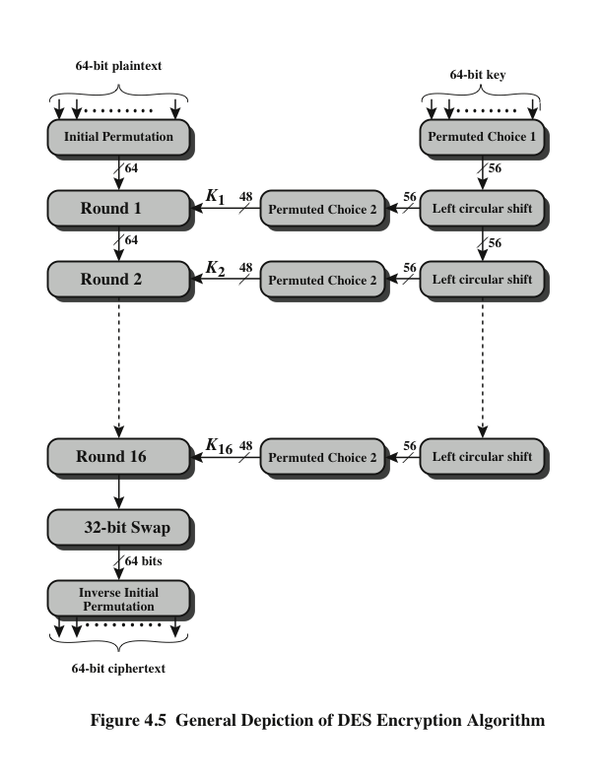
Notes:
The overall scheme for DES encryption is illustrated in Figure 4.5. As with any encryption
scheme, there are two inputs to the encryption function: the plaintext to be
encrypted and the key. In this case, the plaintext must be 64 bits in length and the
key is 56 bits in length.
Looking at the left-hand side of the figure, we can see that the processing
of the plaintext proceeds in three phases. First, the 64-bit plaintext passes through
an initial permutation (IP) that rearranges the bits to produce the permuted input .
This is followed by a phase consisting of sixteen rounds of the same function, which
involves both permutation and substitution functions. The output of the last (sixteenth)
round consists of 64 bits that are a function of the input plaintext and the
key. The left and right halves of the output are swapped to produce the preoutput .
Finally, the preoutput is passed through a permutation [IP ⁻¹ ] that is the inverse of
the initial permutation function, to produce the 64-bit ciphertext. With the exception
of the initial and final permutations, DES has the exact structure of a Feistel
cipher, as shown in Figure 4.3.
The right-hand portion of Figure 4.5 shows the way in which the 56-bit key is
used. Initially, the key is passed through a permutation function. Then, for each of
the sixteen rounds, a subkey (K_{i} ) is produced by the combination of a left circular
shift and a permutation. The permutation function is the same for each round, but a
different subkey is produced because of the repeated shifts of the key bits.
As with any Feistel cipher, decryption uses the same algorithm as encryption,
except that the application of the subkeys is reversed. Additionally, the initial and
final permutations are reversed.

Slide 12
Initial Permutation IP
The first step of the data computation
IP reorders the input data bits
even bits to LH half, odd bits to RH half
quite regular in structure (easy in h/w)
example:
IP(675a6967 5e5a6b5a) = (ffb2194d 004df6fb)
What is the purpose of this?
Notes:
The initial permutation and its inverse are defined by tables, as shown in Stallings Tables 3.2a and 3.2b, respectively. The tables are to be interpreted as follows. The input to a table consists of 64 bits numbered left to right from 1 to 64. The 64 entries in the permutation table contain a permutation of the numbers from 1 to 64. Each entry in the permutation table indicates the position of a numbered input bit in the output, which also consists of 64 bits.
Note that the bit numbering for DES reflects IBM mainframe practice, and is the opposite of what we now mostly use - so be careful! Numbers from Bit 1 (leftmost, most significant) to bit 32/48/64 etc (rightmost, least significant).
Note that examples are specified using hexadecimal.
Here a 64-bit plaintext value of “675a6967 5e5a6b5a” (written in left & right halves) after permuting with IP becomes “ffb2194d 004df6fb”.

Slide 13
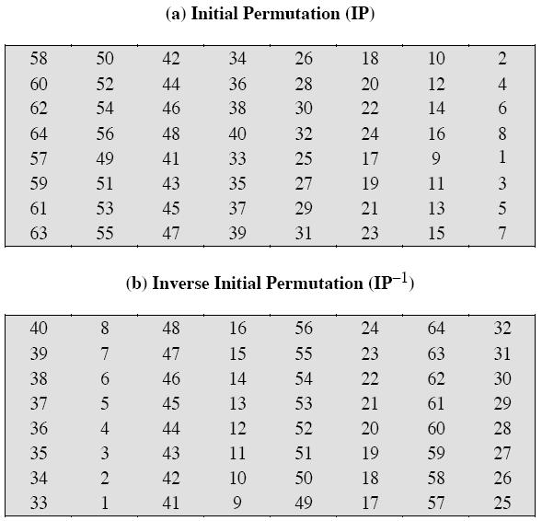
Initial Permutation IP

Slide 14
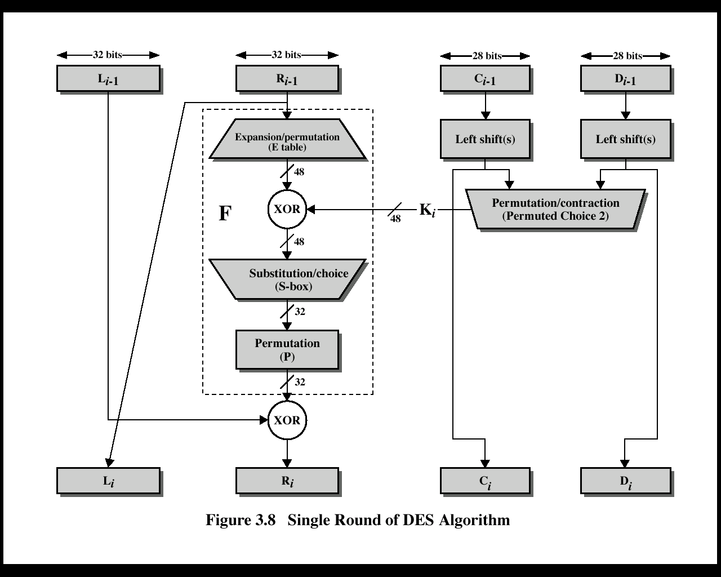
View of a Single Round
Notes:
Note that the s-boxes provide the “confusion” of data and key values, whilst the permutation P then spreads this as widely as possible, so each S-box output affects as many S-box inputs in the next round as possible, giving “diffusion”.
Dashed box (F) is not a permutation of the input 32 bits; it is complex crud that gets added in L_{i-1}.
Each half of the block is modified in this way 8 times total.

Slide 15
Single Round in Words
uses two 32-bit L & R halves
as for any Feistel cipher can describe as:
L_{i} = R_{i–1}
R_{i} = L_{i–1} ⊕ F(R_{i–1}, K_{i})
F takes 32-bit R half and 48-bit subkey:
expands R to 48-bits using perm E
adds to subkey using XOR
passes through 8 S-boxes to get 32-bit result
finally permutes using 32-bit perm P
F is not a permutation!
Notes:
Detail here the internal structure of the DES round function F, which takes R half & subkey, and processes them through E, add subkey, S & P.
This follows the classic structure for a feistel cipher.
Note that the s-boxes provide the “confusion” of data and key values, whilst the permutation P then spreads this as widely as possible, so each S-box output affects as many S-box inputs in the next round as possible, giving “diffusion”.

Slide 16
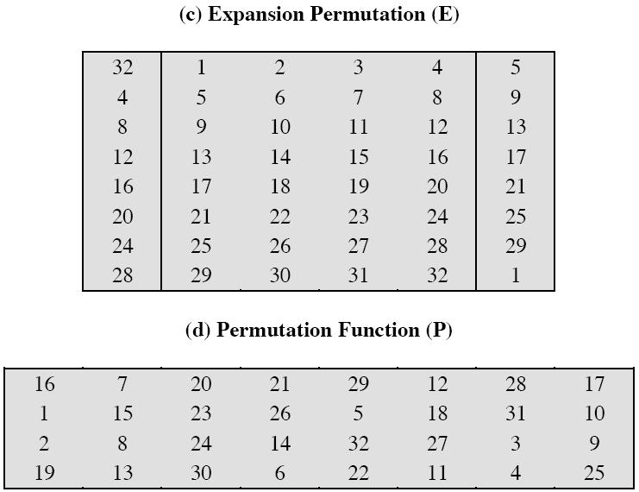

Slide 17
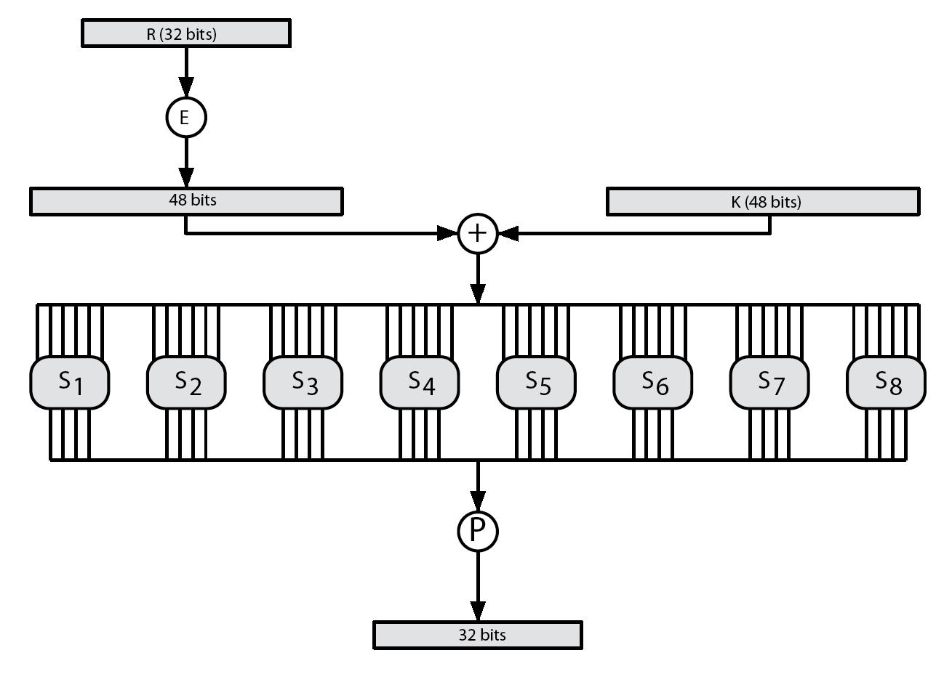
DES Round Function F
Notes:
Stallings Figure 3.6 illustrates the internal structure of the DES round function F. The R input is first expanded to 48 bits by using expansion table E that defines a permutation plus an expansion that involves duplication of 16 of the R bits (Stallings Table 3.2c). The resulting 48 bits are XORed with Ki. This 48-bit result passes through a substitution function comprising 8 S-boxes which each map 6 input bits to 4 output bits, producing a 32-bit output, which is then permuted by permutation P as defined by Stallings Table 3.2d.

Slide 18
Substitution Boxes S
have eight S-boxes which map 6 to 4 bits
each S-box is actually 4 little 4 bit boxes
outer bits 1 & 6 (row bits) select one row of 4 possible 4-bit permutations
inner bits 2-5 (col bits) are substituted
result is 8 lots of 4 bits, or 32 bits
row selection depends on both data & key
feature known as autoclaving (autokeying)
example:
S(18 09 12 3d 11 17 38 39) = 5fd25e03
Notes:
The substitution consists of a set of eight S-boxes, each of which accepts 6 bits as input and produces 4 bits as output. These transformations are defined in Stallings Table 3.3, which is interpreted as follows: The first and last bits of the input to box Si form a 2-bit binary number to select one of four substitutions defined by the four rows in the table for Si. The middle four bits select one of the sixteen columns. The decimal value in the cell selected by the row and column is then converted to its 4-bit representation to produce the output. For example, in S1, for input 011001, the row is 01 (row 1) and the column is 1100 (column 12). The value in row 1, column 12 is 9, so the output is 1001.
The example lists 8 6-bit values (ie 18 in hex is 011000 in binary, 09 hex is 001001 binary, 12 hex is 010010 binary, 3d hex is 111101 binary etc), each of which is replaced following the process detailed above using the appropriate S-box. ie
S1(011000) lookup row 00 col 1100 in S1 to get 5
S2(001001) lookup row 01 col 0100 in S2 to get 15 = f in hex
S3(010010) lookup row 00 col 1001 in S3 to get 13 = d in hex
S4(111101) lookup row 11 col 1110 in S4 to get 2 etc

Slide 19
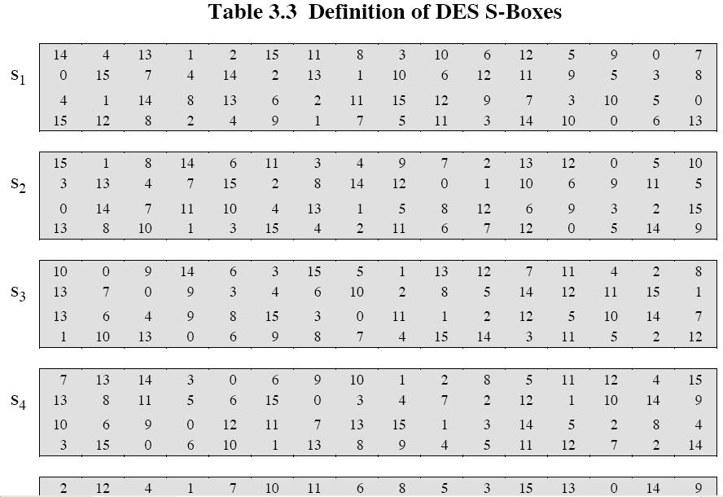

Slide 20
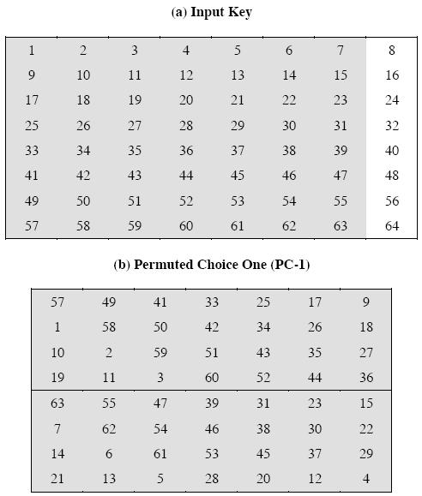

Slide 21
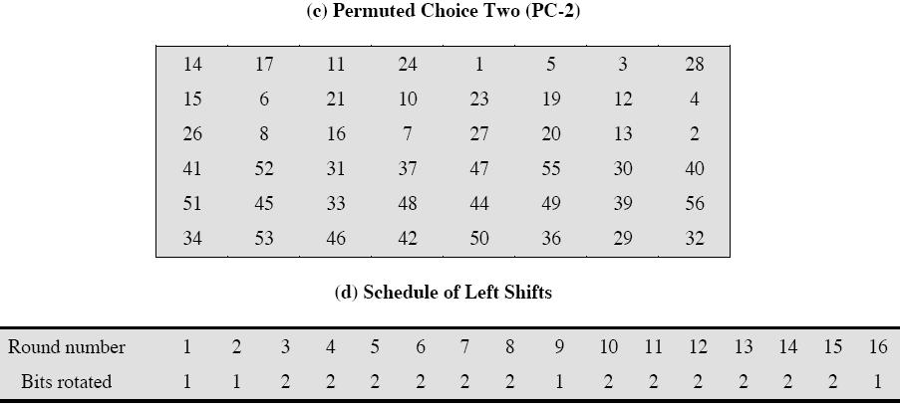

Slide 22
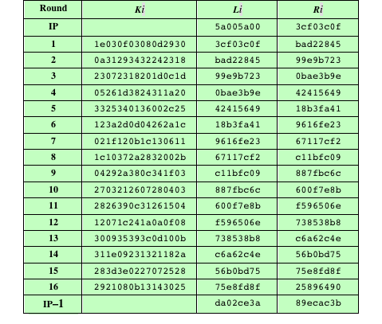
Table 4.2 DES Example
(Table can be found on page 114 in textbook)
Note: DES subkeys are shown as eight 6-bit values in hex format
Notes:
We now work through an example and consider some of its implications. Although
you are not expected to duplicate the example by hand, you will find it informative
to study the hex patterns that occur from one step to the next.
For this example, the plaintext is a hexadecimal palindrome. The plaintext,
key, and resulting ciphertext are as follows:
Plaintext: 02468aceeca86420
Key: 0f1571c947d9e859
Ciphertext: da02ce3a89ecac3b
Table 4.2 shows the progression of the algorithm. The first row shows the 32-bit
values of the left and right halves of data after the initial permutation. The next 16
rows show the results after each round. Also shown is the value of the 48-bit subkey
generated for each round. Note that L_{i} = R_{i-1} . The final row shows the left- and
right-hand values after the inverse initial permutation. These two values combined
form the ciphertext.

Slide 23
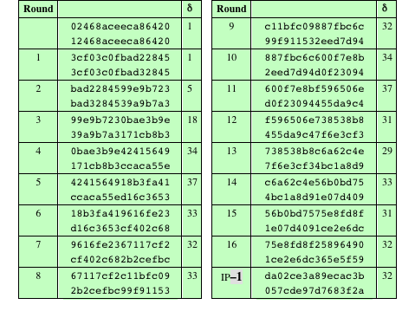
Table 4.3 Avalanche Effect in DES: Change in Plaintext
Notes:
A desirable property of any encryption algorithm is that a small change in either
the plaintext or the key should produce a significant change in the ciphertext. In
particular, a change in one bit of the plaintext or one bit of the key should produce
a change in many bits of the ciphertext. This is referred to as the avalanche effect. If
the change were small, this might provide a way to reduce the size of the plaintext
or key space to be searched.
Using the example from Table 4.2, Table 4.3 shows the result when the fourth
bit of the plaintext is changed, so that the plaintext is 12468aceeca86420 . The
second column of the table shows the intermediate 64-bit values at the end of each
round for the two plaintexts. The third column shows the number of bits that differ
between the two intermediate values. The table shows that, after just three rounds,
18 bits differ between the two blocks. On completion, the two ciphertexts differ in
32 bit positions.

Slide 24
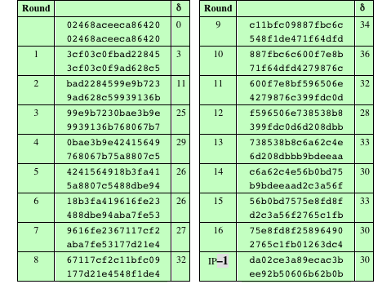
Table 4.4 Avalanche Effect in DES: Change in Key
Notes:
Table 4.4 shows a similar test using the original plaintext of with two keys that
differ in only the fourth bit position: the original key, 0f1571c947d9e859 , and
the altered key, 1f1571c947d9e859 . Again, the results show that about half of
the bits in the ciphertext differ and that the avalanche effect is pronounced after just
a few rounds.

Slide 25
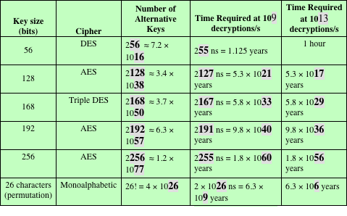
Table 4.5 Average Time Required for Exhaustive Key Search
Notes:
Since its adoption as a federal standard, there have been lingering concerns about
the level of security provided by DES. These concerns, by and large, fall into two
areas: key size and the nature of the algorithm.
With a key length of 56 bits, there are 2⁵⁶ possible keys, which is approximately
7.2 * 10¹⁶ keys. Thus, on the face of it, a brute-force attack appears impractical.
Assuming that, on average, half the key space has to be searched, a single machine
performing one DES encryption per microsecond would take more than a thousand
years to break the cipher.
However, the assumption of one encryption per microsecond is overly conservative.
As far back as 1977, Diffie and Hellman postulated that the technology
existed to build a parallel machine with 1 million encryption devices, each of which
could perform one encryption per microsecond [DIFF77]. This would bring the
average search time down to about 10 hours. The authors estimated that the cost
would be about $20 million in 1977 dollars.
With current technology, it is not even necessary to use special, purpose-built
hardware. Rather, the speed of commercial, off-the-shelf processors threaten the
security of DES. A recent paper from Seagate Technology [SEAG08] suggests that
a rate of 1 billion (10⁹ ) key combinations per second is reasonable for today’s multicore
computers. Recent offerings confirm this. Both Intel and AMD now offer
hardware-based instructions to accelerate the use of AES. Tests run on a contemporary
multicore Intel machine resulted in an encryption rate of about half a billion
encryptions per second [BASU12]. Another recent analysis suggests that with
contemporary supercomputer technology, a rate of 10¹³ encryptions per second is
reasonable [AROR12].
With these results in mind, Table 4.5 shows how much time is required for
a brute-force attack for various key sizes. As can be seen, a single PC can break
DES in about a year; if multiple PCs work in parallel, the time is drastically shortened.
And today’s supercomputers should be able to find a key in about an hour.
Key sizes of 128 bits or greater are effectively unbreakable using simply a brute-force
approach. Even if we managed to speed up the attacking system by a factor
of 1 trillion (10¹² ), it would still take over 100,000 years to break a code using a
128-bit key.
Fortunately, there are a number of alternatives to DES, the most important of
which are AES and triple DES, discussed in Chapters 6 and 7, respectively.

Slide 26
Avalanche Effect
key desirable property of encryption alg
where a change of one input or key bit results in changing approx half output bits
making attempts to “home-in” by guessing keys impossible
DES exhibits strong avalanche
Notes:
A desirable property of any encryption algorithm is that a small change in either the plaintext or the key should produce a significant change in the ciphertext. In particular, a change in one bit of the plaintext or one bit of the key should produce a change in many bits of the ciphertext. If the change were small, this might provide a way to reduce the size of the plaintext or key space to be searched. DES exhibits a strong avalanche effect, as may be seen in Stallings Table 3.5.

Slide 27
Summary
Traditional Block Cipher Structure
Stream ciphers
Block ciphers
Motivation for the Feistel cipher structure
Feistel cipher
The Data Encryption Standard (DES)
Encryption
Decryption
Avalanche effect
The strength of DES
Use of 56-bit keys
Nature of the DES algorithm
Timing attacks
Block cipher design principles
Number of rounds
Design of function F
Key schedule algorithm
Notes:
Chapter 4 summary.

